Slide 1
U.S. DEPARTMENT OF STATE
BUREAU OF DIPLOMATIC SECURITY
  Making Meaningful Recommendations:
  Understanding the Stakeholder
Presenter: Carimanda Baynard
September 26, 2016

Slide 2
Agenda
Speaker Introduction
Diplomatic Security Evaluation Program
Understanding the Stakeholder
    Internal Evaluations
    Brand Recognition
Meaningful Evaluation Recommendations
Video & Discussion
Questions

Slide 3
Speaker Introduction
Ms. Carimanda Baynard provides evaluation and strategic communications expertise to the Bureau of Diplomatic Security within the United States Department of State. She has the responsibility for monitoring and implementing program evaluations and ensuring strategic communication efforts align with the Bureau’s mission.
A graduate of the National Intelligence University, she obtained her Masters of Science degree in Strategic Intelligence, a Masters of Arts in Public Sociology from American University, and a Bachelor of Arts in Sociology from Washington College. She has a passion for crisis communications, strategic planning, and organizational evaluations designed to support national security efforts.

Slide 4
Bureau of Diplomatic Security
Mission:
The mission of the Bureau of Diplomatic Security is to provide safe and secure platform for the conduct of U.S. foreign policy through the protection of life, property, and information.
DS Evaluation Program:
The DS evaluations program primarily uses a mixed methods approach to ensure that findings and recommendations address the objectives of the evaluation, enhance customer service, and support the objectives of improved efficiencies and overall program management in support of national security efforts. Through program and process evaluations, DS strives to use evaluation results to improve strategic planning, performance management and reporting, examine and rectify duplication of efforts, and ultimately achieve greater accountability.

Slide 5
Understanding the Stakeholder
“While evaluation staff are interested in long term programmatic impacts, program staff are more interested in shorter-term projects. Evaluations can be a burden for program offices, given their workload.”
GAO: Strategies to Facilitate Agencies’ Use of Evaluation in Program and Policy Making”
Programmatic priorities
Evaluation areas of focus
Necessity of an evaluation
Benefits of an evaluation
Concerns and projected timeline

Slide 6
Brand Recognition
30 Day Evaluation
60 Day Evaluation
Short and long term strategic planning
90 Day Evaluation
Combining services offered in both the 30 and 60 day options
Workforce planning
To assess operational proficiency and readiness
Mid and end of year performance planning
Depending on the necessity of programmatic concerns, the 90 day option can start the planning process for another assessment conducted by external evaluators
Strength Weakness Opportunities and Threats (SWOT) analysis
Organizational effectiveness and process mapping (w/gap analysis)

Slide 7
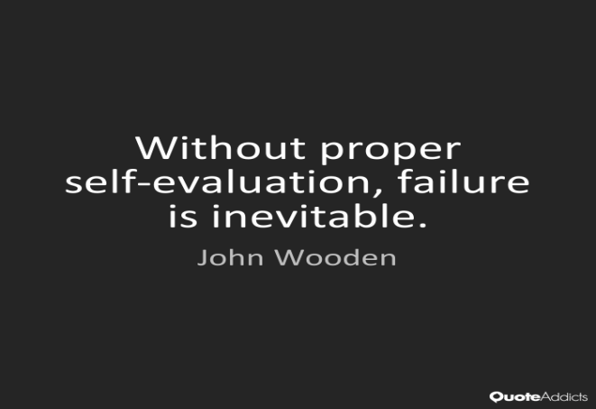
Internal Evaluations
  Internal Policy and Planning Division Evaluation
  Evaluation Questions
  Mixed Methods Approach
  Recommendations and Next Steps

Slide 8
Making Meaningful Recommendations
Demonstrate leadership support of evaluations for accountability and process improvement.
Build strong supporting evidence through methodology to support policy decisions.
Engage stakeholders throughout the evaluation process to gain their input and insight.
  GAO: Strategies to Facilitate Agencies’ Use of Evaluation in Program and Policy Making”

Slide 9
Discussion Questions
Is your agency a learning organization?
How do you build a learning organization?
Are there successes and/or challenges to building a learning organization?
How can evaluations impact and shape organizational structure to promote process improvement, productivity, and operational proficiency?
Video: https://www.youtube.com/watch?v=j1xE3x9_AP0

Slide 10
“The process by which evaluation influences change is messy and complex. Policy changes do not occur as a direct result of an evaluation question; rather a body of evaluation results, research, and other evidence influences policy and practice over time.”
  GAO: Strategies to Facilitate Agencies’ Use of Evaluation in Program and Policy Making”

Slide 11


